Slide 1


Project management with Git Flow
Presentation by David Weis

Slide 2
VCS Introduction
Imagine you’re working in a team.
How do you:
Share code with each other?
Especially offline
Back up your code?
Track history of your code?
Who wrote what, when?

Slide 3
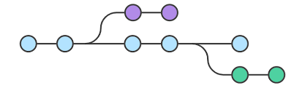
VCS Introduction
The (hopefully obvious) answer is:
You use a tool.
Version control (aka source control) tools do all these things and more.
VCS has been around since the late 1970s.
These tools help you safely share and backup code.
There is no other reliable way to do this!
Every time you share code over Dropbox, God kills a kitten!
And deletes a random line in your code.

Slide 4
What is Git?
Git is a distributed version control system.
In a distributed system every developer keeps their own copy of the code.
In a centralized system the code is stored in one central place.
Referred to by its creator, Linus Torvalds, as a “stupid content tracker”.
Created in 2005 to help develop the Linux kernel.
Nothing else was fast enough or suitable for distributed teams.
It is extremely powerful, but the core features are simple.
Git is by far the most popular VCS tool today.
It is free, and open source under the GNU General Public License.

Slide 5
What is GitHub?
GitHub is the most popular Git repository hosting service.
One of many (BitBucket, GitLab,…)
Git does not belong to GitHub!
GitHub focuses on open source.
Repositories are public by default.
Private repositories are paid (free for students!).
Many other features beside Git
Feature planning, bug tracking,…
Hosting your portfolio for free (GitHub Pages)

Slide 6

GitHub Student Developer Pack
Great free resources for students!
Lasts as long as you are a student.
Has to be renewed every few years
https://education.github.com/pack

Slide 7
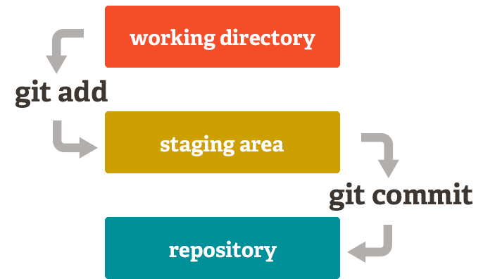
Basic terms
Repository
Staging area
Commit
Remote
Branch
Collaborator

Slide 8
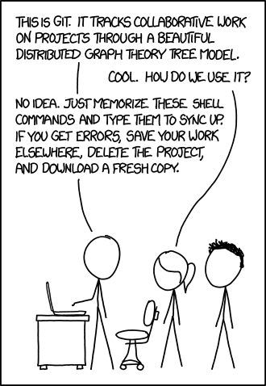
Git Commands
git init
git status
git add <filename> | -A
git commit –m
git pull
git push

Slide 9
.gitignore
You don’t want to store nonsense Eclipse files in your code repository!
Git lets you specify files that should be ignored.
All you have to do is place a .gitignore file in the root of your repository.
A collection of ready-made .gitignore files is here: github.com/github/gitignore
Some IDEs (Visual studio, IntelliJ,…) create a .gitignore for you.
If you are creating a .gitignore file on windows you have to name it “.gitignore.”

Slide 10
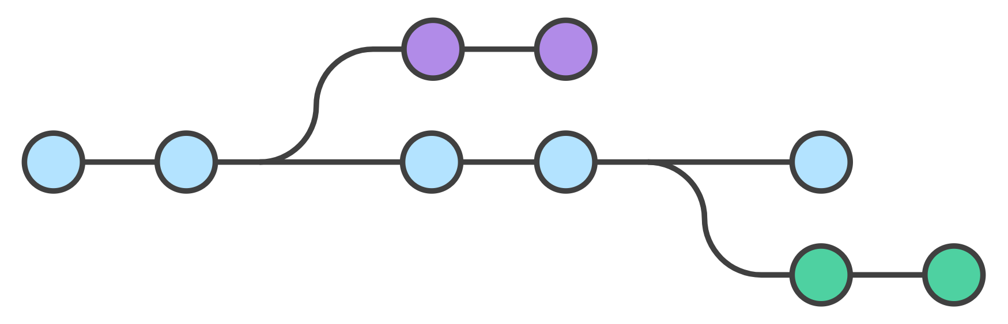
Branching
Branching and Merging in Git is simple
As opposed to other VCS systems
Merge conflicts are not something you evade
They are easy to resolve
Common names
Master
Develop
Release
In low level terms Branch is a pointer to the latest commit
Git branching in a nutshell

Slide 11
Merge conflicts
They will happen!
They are not bad!
A merge conflict means that there were two different changes done that are incompatible and you are trying to merge them.
To resolve this, go into the conflicting files, edit them to the version you’d like, and then make a new commit.

Slide 12
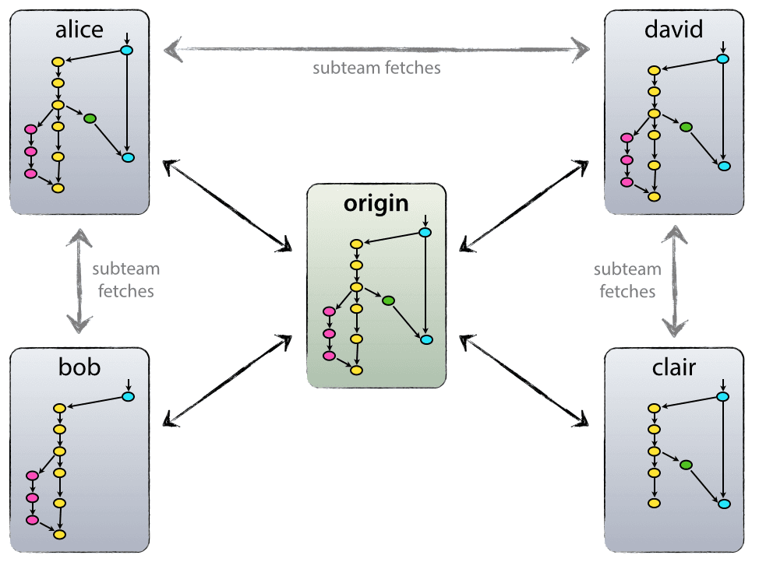
Remotes
Git is decentralized but!
Origin is the True Repository
Origin/master is branch master at remote origin
Local version of a remote branch is a separate branch

Slide 13
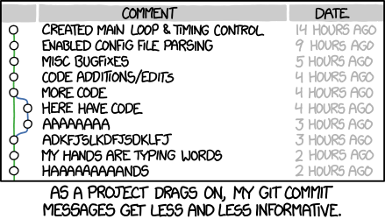
Commit messages
Important because they create history
Short and concise
If applied, this commit will…
What-with what-where
“Fix typo in introduction to user guide”
Great blog post: chris.beams.io/posts/git-commit/

Slide 14
Commit messages
Subject and body separated by a blank line
Subject
In imperative style
Starts with capital letter
No period at the end
No more than 50 characters
Body
Wrap after 72 characters
Explain What and Why rather than how

Slide 15

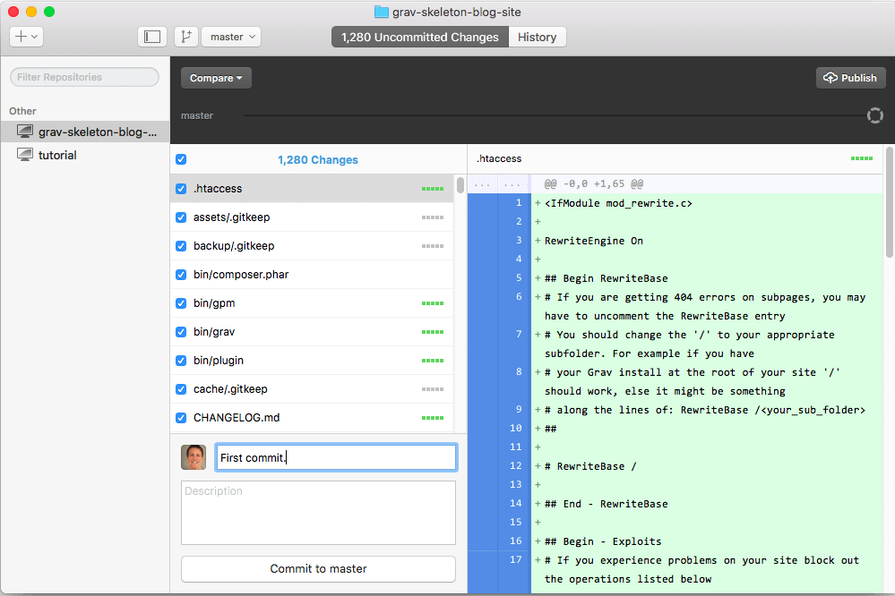
GitHub Desktop
If you hate the command line, there are many applications for Git.
GitHub Desktop is the easiest to use:
On Windows and Mac
Comes in two versions
Old version is really good
New version is in beta
Links with GitHub account
Works with non GitHub repositories too
https://desktop.github.com/

Slide 16
Git flow
Development model
Takes advantage of Git and branching
Incorporates code reviews and tests
branches for separating features, releases and hotfixes
Origianl post by Vincent Driessen
Atlassian comparing-workflows gitflow

Slide 17

Git flow branches
Two main branches
Develop
Branch holding currently worked on version of the code
Master
Branch holds releases of software
Temporary branches
Feature
Each feature is a separate branch
Release
Separate branch for pre release preparation
Hotfix
Fixes for releases

Slide 18
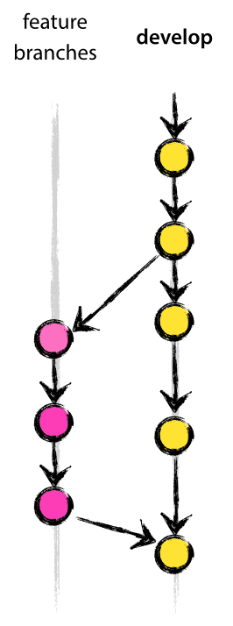
Feature branch
May branch form Develop
Must merge to Develop
Name can be anything
Should start with word Feature
Pull request used to merge back into Develop
Pull request should be Reviewed
Deleted once it’s merged

Slide 19
Release branch
May branch form Develop
Must merge to Master (can merge to Develop)
Name should be Release-*
* could be release number
Changes before release take place here
Minor bug fixes
Release number is added here

Slide 20
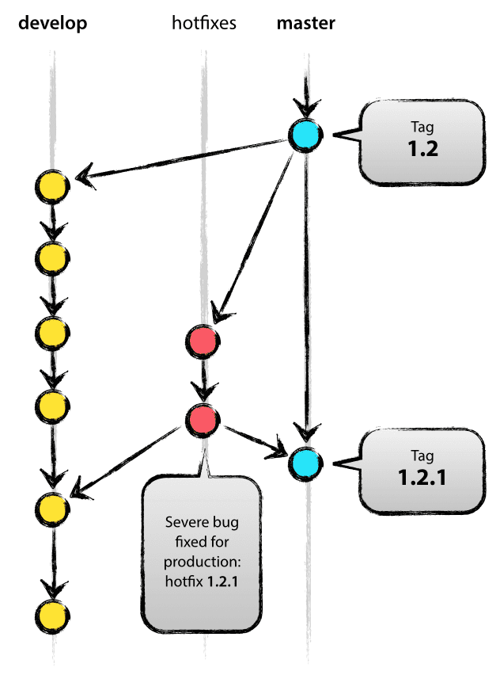
Hotfix branch
May branch form Master or Develop
Must merge to Master and/or Develop
Name hotfix-*

Slide 21
Pull request
Not a git term, not part of original gitflow
Used in VSTS, Jira, GitHub
Requests that changes are applied to main branch
List of changes, commits and reasons for changes
Can automatically run test!
Has to be reviewed by at least one another person

Slide 22
<pull request demo>

Slide 23
Day in a life of a developer
Take a feature from the backlog
Create Feature branch for feature
Commit changes on Feature branch
Open a Pull Request to merge back to Develop
Test automatically verify new code
Another developer Reviews the Pull Request
Optional code review
Feature branch is merged to develop and deleted
Repeat

Slide 24
Benefits
Code on develop will always work
If developer accidentally breaks something develop stays clean until pull request is resolved
At least two developers are aware of all changes to the code
Enforces regular tests and code reviews
Problematic features are easy to remove
History of code is obvious from Git log
Code for each release is separate so you can always go back
Many, many more

Slide 25
Disadvantages
Introduces overhead
Release model is not always perfect
GitHub flow is a modified version of Git Flow for continuous deployment
Has no concept of release
Master is always ready to release
Some developer believe that simple code changes do not need a code review

Slide 26
Git Resources
Git command line tutorial – Best starting place.
https://try.github.io
Pro Git – Perfect (and free!) e-book about Git.
Pro Git
First-Aid Git - Great place to look for quick solutions.
http://firstaidgit.io/#/
Git fix Um - Great place to search for solutions.
sethrobertson.github.io/GitFixUm

Slide 27


